Slide 1

Common logical errors and debugging techniques
Notes:
Last class, we looked at mathematical and comparison operators and translating flowcharts to pseudocode.
We also looked at nested constructs and identified structural relationships between flowcharts and pseudocode.
We had a little bit of time to practice creating pseudocode from flowcharts and from problem statements.
So today, we will look at common logical errors and debugging techniques.
But before we start, are there any questions on what we have covered so far?
I do want to address a couple of things from last class:
Simran asked about the single equal sign vs the double equal sign. The single equal sign is for ASSIGNMENT (eg. counter = counter + 1 or DECLARE total = 23), The double equal sign is used for comparison, essentially checking if 2 values are equal.
Simran again, asked about the IF statement being outside the DO Loop. It needs to be inside the loop.
Just a reminder that Quiz 3, which is going to be released after this class, is due on Friday AND that there is another in-class assignment being done on Friday.
So please be on time. It will be a similar format as the first one and I will talk a bit about it at the end of this PPT. Both the Quiz and the In-class assessment will cover content INCLUDING today’s lesson.

Slide 2
Lesson Objectives
Identify common logical errors in pseudocode
Apply systematic debugging techniques to locate and fix errors
Develop a structured approach to verifying the correctness of pseudocode
Notes:
So our lesson objectives for today are……..

Slide 3
Logical errors

Slide 4
Logical Errors
Problem with the algorithm design that cause incorrect or unexpected behavior
For example:
  Incorrect comparisons
  Logic flow in an incorrect order
  A single missing line
Notes:
It is rare that the code we write will be perfect from the very beginning.
There will be many errors of different types.
Now, Because pseudocode is not specific to any programming language, the most common errors we will deal with are logical errors as opposed to errors if syntax. Logical errors are when there is something in our logic or algorithm that would cause incorrect behaviour.
Some errors can be obvious, and others subtle. The more exposure you have to different errors, the better you will be at identifying them.

Slide 5
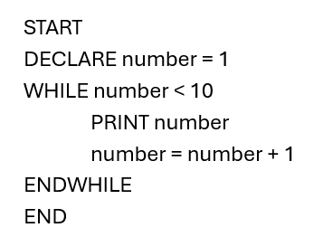
Program to Count to 10
Notes:
So let's look at this first bit of pseudocode.
It is for a program that will print the numbers 1 to 10.
I’ll give you a few seconds to take a look at this….
If we examine this example closely, we can see that there is an error. This
program almost behaves the way we want, but the number “10” will never
be printed. Only the numbers 1 to 9 will be printed. Why?
The problem here is the logic in our WHILE loop. The exit condition, when the
loop will stop, is when the number reaches 10. With every iteration of the
loop, the value of “number” increases by 1. When the value of “number”
reaches 10, the loop will no longer execute and the program will end.

Slide 6
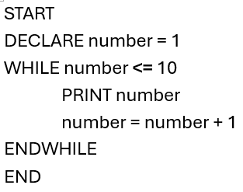
Program to Count to 10
Notes:
Fortunately, the fix for this is quite simple. We need to change the comparison operator being used in the WHILE loop.
By changing the “less than” operator to a “less than or equal to” operator, we've included 10 as part of the loop.
So now the number 10 will print.

Slide 7
Sum a Series of Numbers
User enters whole number
Calculate sum of all numbers starting from 1 up to the user’s number
Display total sum
E.g. user enters 5, sum 1 + 2 + 3 + 4 + 5
Notes:
So how about this one....Sum a series of numbers
Write a program that asks the user to enter a whole number. The program should then calculate the sum of all the numbers starting from 1 up to the number the user entered.
Finally, it should display the total sum.
For example, if the user enters 5, the program should calculate:
1 + 2 + 3 + 4 + 5 = 15
and then print 15 as the result.

Slide 8
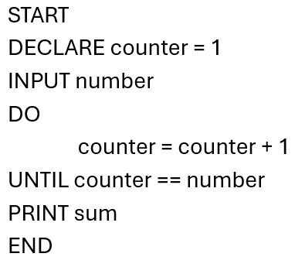
Sum a Series of Numbers
Notes:
Take a look at this logic. (Pause.)
Once again, this program will not give us the output we want. There are actually a couple errors here preventing us from getting the expected result.

Slide 9
Sum a Series of Numbers - Errors
Never declared “sum” variable
Never performed the sum operation of the numbers in our while loop
Notes:
1. We never declare the variable “sum”, but we try to use it at the end of the program
2. We never perform the sum operation in our Do-Until loop

Slide 10
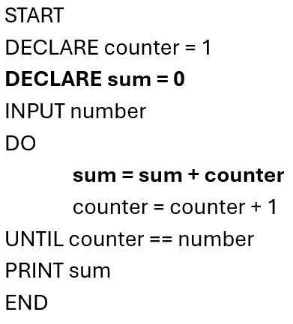
Sum a Series of Numbers - Fix
Notes:
Let’s look at the fix:
To fix the first issue, we first needed to declare the “sum” variable at the top.
You cannot use a variable before you declare it and initialize it. We initialize it to 0 because the sum starts off at 0.
Secondly, we add the value of counter to the existing value of sum. Every time we go through the loop, we are adding the value of “counter”, which increments with each loop, to the existing value of “sum”.
This gives us the 1 + 2 + 3 + 4 + 5 behavior we are looking for.

Slide 11
Infinite Loops
Looping construct that runs forever
Often due to logical errors
Can be very destructive to an application
Notes:
If we are not careful with our looping logic, it can be possible to create what is known as an “infinite loop.”
As you can imagine, this is a looping construct that never ends because the logic used when writing it provides it with no way out.
It will continue to execute forever, hence the name.

Slide 12
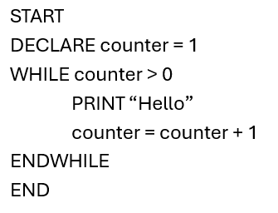
Infinite Loop - Example
Notes:
Take the following program: (PAUSE)
If we look at the logic in this WHILE loop, we can see that we will repeat the loop as long as the “counter” variable is greater than 0. In the while loop code itself, all we do is increase the value of “counter”, so it just goes on to infinity and will never stop.
This is just a simple example, but the idea is that if the logic in the WHILE loop is always true, the loop will always run.
Infinite loops can be easy to miss and are serious issues in an application.
They will devour a computer’s memory and cause the application to crash.

Slide 13
debugging

Slide 14
Debugging
The process of troubleshooting code
How the causes of errors are identified and fixed
Very important skill for software developers
Notes:
The process of troubleshooting code in software development is known as debugging.
The term comes from an issue in the 1940s when a moth was discovered inside a computer that made the computer malfunction.
When the moth was removed, the issue was fixed, and the computer was said to have been “debugged.”

Slide 15
Debugging - Steps
Understand the problem,
Determine requirements
Focus on small pieces at a time
Verify solution meets the requirements
Refine the solution (if necessary)
Notes:
When it comes to debugging pseudocode, there are some reliable techniques that can be used, some of which you are already familiar with.
1. Understand the problem.
2. Determine the inputs, processes, outputs, and constraints.
3. Focus on small pieces at a time.
Very often, one line of code can be the source of the bug, as our example with counting to 10 showed.
Other times, there could be issues in multiple places that prevent the solution from working, as our summation example showed.
When debugging, focusing on one small piece at a time is best. Fix one issue, then move onto the next, until the solution works completely.
4. Verify that the solution meets all inputs, processes, outputs, and constraints.
Once you have identified the requirements of the problem, you can compare each of these requirements to the solution one at a time, making sure each are met.
This is done together with the part about focusing on one piece at a time.
The best way to illustrate the debugging process is with examples, so let’s look a couple of them and break them down.
(5. Refine the solution as necessary.)
But before we continue, let's not forget the fifth step, and that is to refine the solution as necessary. This is always a valid option or technique and should be used liberally.

Slide 16
Debugging example

Slide 17
Generation Calculator
User enters their age
Program will repeatedly ask the user to enter a positive number.
Error should print if they enter a negative number.
Notes:
Write a program that takes in a number for a user’s age. This input will determine which generation that person belongs to, and then print it.
The program should repeatedly ask the user for a positive number. If they enter a negative number, then an error should print.

Slide 18
Generation Calculator
Baby boomer: age 60+
Gen X: age 45-60
Millennial: age 29-44
Gen Z: age 13-28
Gen Alpha: age 0-12
Notes:
If the age is over 60, then the user is a Baby Boomer.
If they are 45-60 they are Gen X.
If they are 29-44 they are Millennials.
If they are 13-28 they are Gen Z.
Otherwise, they are Gen Alpha.

Slide 19
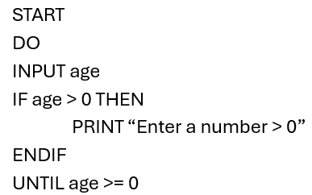
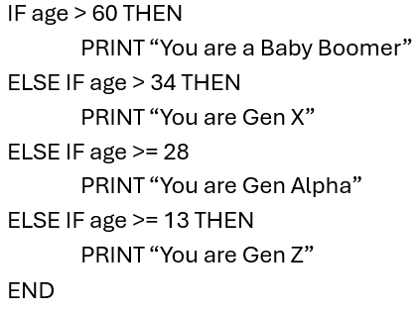







Solution with errors
Notes:
Here is a solution with errors: (PAUSE)
There are a number of problems with this solution. Some are logical and will affect the functionality of the program.
Some are best practices and although they will not affect the actual functionality, quality is compromised and during refinement should be addressed.
Let’s start by identifying the inputs, processes, outputs, and constraints:

Slide 20
Debugging – Age Input

Slide 21
Debugging – Age Input Requirements
Input: User’s age
Validation of user input
Error message on negative number
Repeat until positive number is given
Age must be greater than 0
Notes:
Let’s start by identifying the inputs, processes, outputs, and constraints:
• Input
o User’s age
• Processes
o Conditionals based on the age
o Validation of user input, error message on negative number
o Repeatedly ask user for input until a positive number is given
• Output
o Message displaying the user’s generation
• Constraints
o Age must be greater than 0
o Baby Boomers are older than 60
o Gen X is 45-60
o Millennials are 29-44
o Gen Z is 13-28
o Gen Alpha is younger than 13
Now that we have identified the requirements, let’s break down the solution into smaller pieces starting from the top. We will first look at the age input.

Slide 22
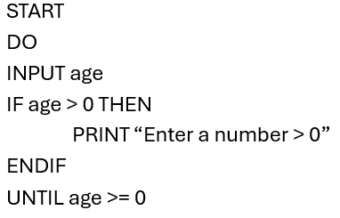
Debugging – Age Input
Notes:
Debugging -Age Input
By comparing this pseudocode to the problem statement, we can tell that this is where we are getting the user’s age.
Let's revisit the requirements and see which are related to the user’s age:
• INPUT: user’s age
• Validation of user input, error message on negative number
• Repeatedly ask user for input until a positive number is given
• Age must be greater than 0
Looking at the first point, we need to get an input from the user for their age.
We do have the INPUT age statement, which is good. We can also DECLARE the variable before using it with INPUT, but it is not required. I just mention this because it IS done in this example.

Slide 23
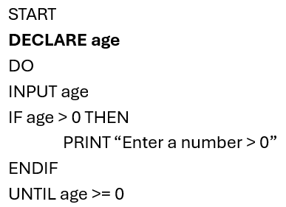
Debugging – Age Input
Notes:
Next, to address the second point....validation of the user INPUT. So, IF the number they entered is less than 0, we want to print an error message.
This requires an IF-THEN statement, which we have. We also have a PRINT statement that will print a message.
But, if we look at the logic in the IF-THEN statement, we see that the error would print if the INPUTTED age is GREATER THAN zero, not less than or equal to (which is what it should be).
----------
Let's revisit the requirements and see which are related to the user’s age:
• INPUT: user’s age
• Validation of user input, error message on negative number
• Repeatedly ask user for input until a positive number is given
• Age must be greater than 0
age entered is greater than 0, not less than or equal to.

Slide 24
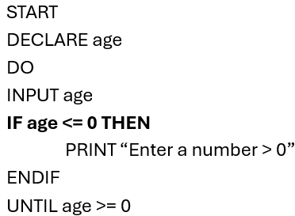
Debugging – Age Input
Notes:
To fix this, we simply change the “greater than” symbol to a “less than or equal to” symbol.
-----
Let's revisit the requirements and see which are related to the user’s age:
• INPUT: user’s age
• Validation of user input, error message on negative number
• Repeatedly ask user for input until a positive number is given
• Age must be greater than 0

Slide 25
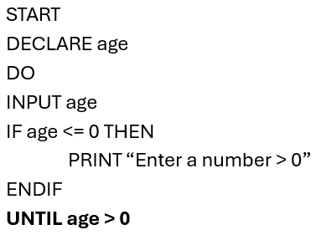
Debugging – Age Input
Notes:
Lastly, we check if the repetition is happening until the number is positive.
Our DO-UNTIL loop logic is checking >= 0. 0 is not a positive number, so it should be updated to > 0.
This small section is now complete and debugged.

Slide 26
Debugging – Generation Check

Slide 27
Debugging – Generation Check Requirements
Output: Message to user
Conditionals based on age:
  Baby boomer: age 60+
  Gen X: age 45-60
  Millennial: age 29-44
  Gen Z: age 13-28
  Gen Alpha: age 0-12
Notes:
The second section of the solution is where we perform our logic based on the user input and determine which generation the user belongs to.
Let’s look at the problem statement and see which requirements relate to this part of the pseudocode:
• OUTPUT: Message displaying the user’s generation
• Conditionals based on age
• Baby Boomers are older than 60
• Gen X is 45-60
• Millennials are 29-44
• Gen Z is 13-28
• Gen Alpha is younger than 13

Slide 28
Debugging – Generation Check
Notes:
Starting from the top, we can see that each IF statement we have contains a message printing the user’s generation, so we are good there.
We also have the conditionals necessary for checking each age group.

Slide 29

Debugging – Baby Boomer Check
Notes:
Now let’s investigate the IF statements one at a time.
Our first IF statement is saying that if the age is greater than 60, the user is a baby boomer. This logic is correct and matches our requirement.

Slide 30

Debugging – Gen X Check
Notes:
This next statement is saying that if the user is greater than 34, then they are Gen X.
This is incorrect, since our requirements state that Gen X is greater than 44, not 34.

Slide 31

Debugging – Gen X Check
Notes:
So, the fix for this is to change “34” to “44”.

Slide 32

Debugging – Millennial Check
Notes:
The next if statement should be checking the age range for Millennials, but there are a few problems. Can anyone see them?
The first is the IF statement. The requirement is that Millennials are from the age range 29-44, but the logic in the IF statement is including the number
28, which is incorrect. It is also missing the “THEN” keyword that is required for the IF-THEN syntax. And, of course the PRINT message is wrong.

Slide 33

Debugging – Millennial Check
Notes:
To fix this, we can either change the “>=” to a “>” or change “28” to “29”.
Here they did the second way.
So that fixes the issue.
The other problem is with the message. It should output “Millennial”, not “Gen Alpha”.
Here, they have also fixed this issue.
And a THEN was added to the IF-THEN statement

Slide 34

Debugging – Gen Z Check
Notes:
The logic for the Gen Z if statement is correct. 13 is included in the comparison and the message has the correct generation.

Slide 35
Debugging – Gen Alpha Check
?
Notes:
Now lastly, Gen Alpha. It looks like the message for Gen Alpha is missing entirely. We could address this in two ways. The first is by adding another ELSE-IF:
ELSE IF age >= 0 THEN
PRINT “You are Gen Alpha”
But this is unnecessary. Since there are no other conditions to check for in our requirements, so we can just use an ELSE:

Slide 36

Debugging – Gen Alpha Check
Notes:
ELSE
PRINT “You are Gen Alpha”

Slide 37
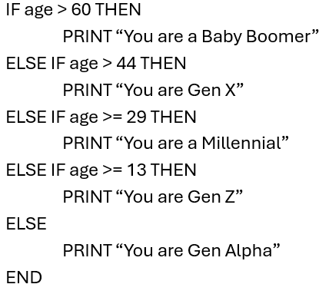
Debugging – Generation Check
Notes:
That captures all of the IF statements.
Is there anything else?

Slide 38
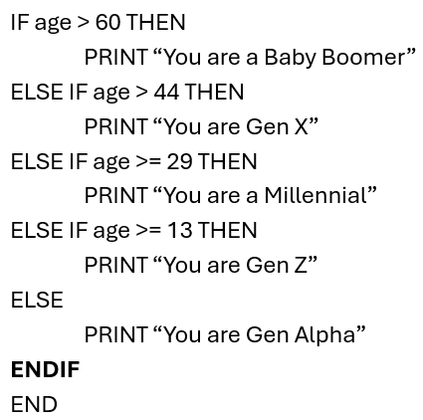
Debugging – Generation Check
Notes:
One last thing before moving on to refinement.
Every IF-THEN-ELSE statement should have an ENDIF, but that is missing from our solution.
This must be addressed before moving on.
ELSE
PRINT “You are Gen Alpha”
ENDIF
So the final updated version now should look like this.

Slide 39
Refinement
Notes:
Now to refine the solution.

Slide 40
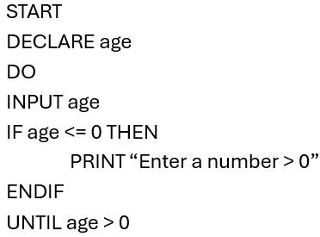
Refinement – Age Input
Notes:
The solution as it stands has been debugged, but there is still room for improvement.
Once again, let’s break it into smaller pieces, starting with the age input.
While the logic is correct, it isn’t as readable as it could be.

Slide 41
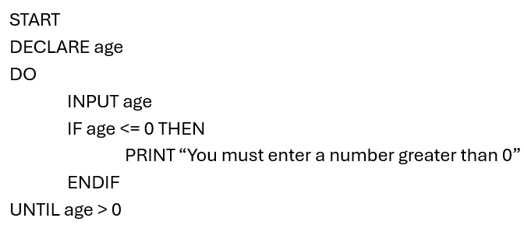
Refinement – Age Input
Notes:
To follow best practices, everything inside of the DO-UNTIL loop should be indented.
Additionally, the error message isn’t as user friendly as it could be.
It would be better to use language than the greater than symbol.

Slide 42
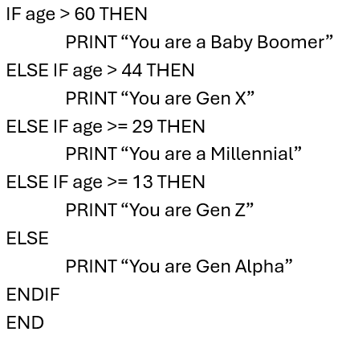
Refinement – Generation Check
Notes:
Our solution for the Generation Check looks like this:
The indentation is correct, and the solution is readable. But the logic, while correct, is not consistent.
If we look closely, we notice that two of the IF statements use “greater than” symbols, and the other two use “greater than or equal to” symbols.
In programming, consistency is key to good coding. In this situation, we should update our logic to use either all “greater than” symbols or all “greater than or equal" symbols. Let’s choose the “greater than” symbols.

Slide 43
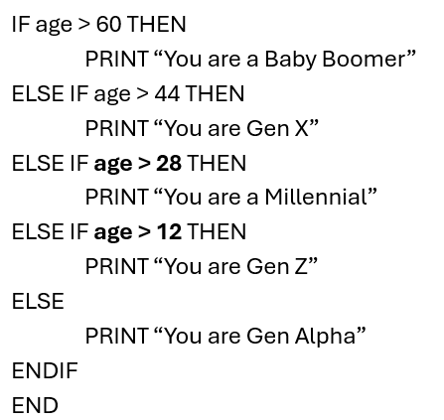
Refinement – Generation Check
Notes:
Notice how when the symbol changed, the number we were comparing against also had to change so that our logic continued as expected.

Slide 44
Original Solution with Errors
Notes:
So here is our Original Solution with Errors.

Slide 45
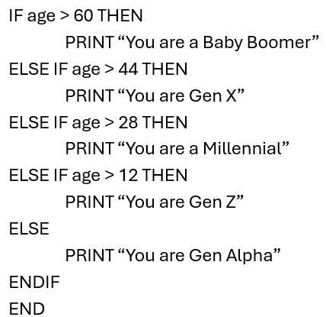
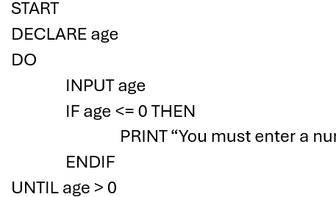




Complete solution
Notes:
And here is our Complete, Debugged, and Refined solution.

Slide 46
Refactoring
• Time consuming
• Potential to introduce errors
• Partially avoidable if code is written right the first
time
Notes:
Refactoring is the process of going back to existing, working code and improving it. As applications grow, they can become more complex, and some design patterns that made sense at the time are no longer applicable to a larger application.
It may be necessary to update the legacy code and update or replace existing design patterns.
There are a couple main reasons to minimize the need for refactoring.
1. It can be very time consuming. Depending on the task, you might need to update many parts of the application. A major refactor could take weeks or months to complete.
2. With any code change, there is the risk of introducing errors. The more complex the code change, the higher the risk. Replacing working design patterns with new ones could easily introduce errors if not done carefully.
We can reduce the need for any refactoring by writing code right the first time. Things to keep in mind is scalability, efficiency, and ease of understanding.

Slide 47
Lesson Summary
Introduced and discussed logical errors
Explained debugging
Created a structured approach to debugging
Debugged a program using the structured approach

